Slide 1

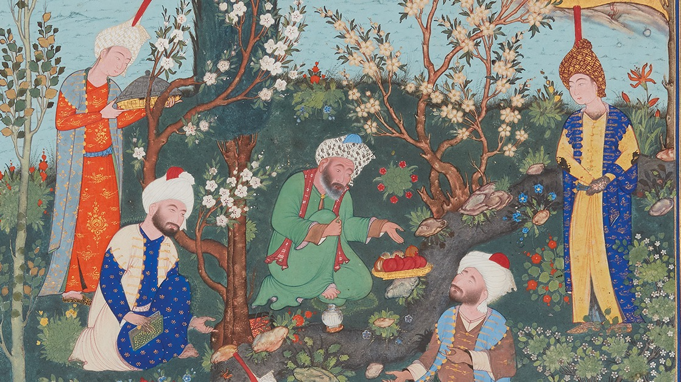
COMPANION SLIDES MYP1
PARKS AND GARDENS
AS SANCTUARIES
Notes:
These slides are for use with the Teacher Guide for the MYP1 Interdisciplinary unit: Parks and Gardens as Sanctuaries. Please read the Teacher Guide before using the slides.

Slide 2

LESSON 1.3:
PARKS AND GARDENS
AS SANCTUARIES

Slide 3
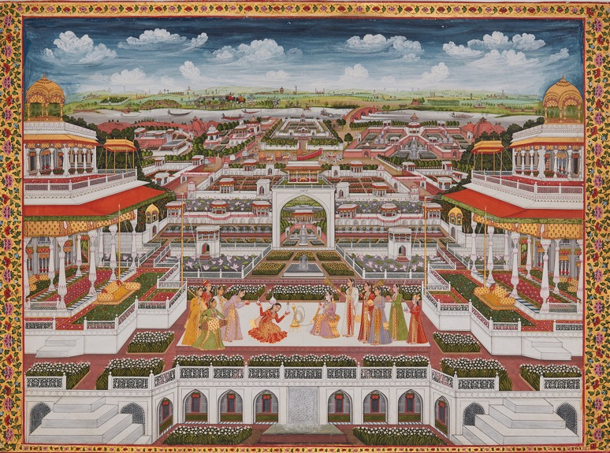
Entertainment in a Palace
Signed by Faizabad Faizullah, India, ca.
1765–1770,
Opaque watercolour and gold on paper, 50.5 cm × 69.2 cm
© The Aga Khan Museum, AKM921

Slide 4
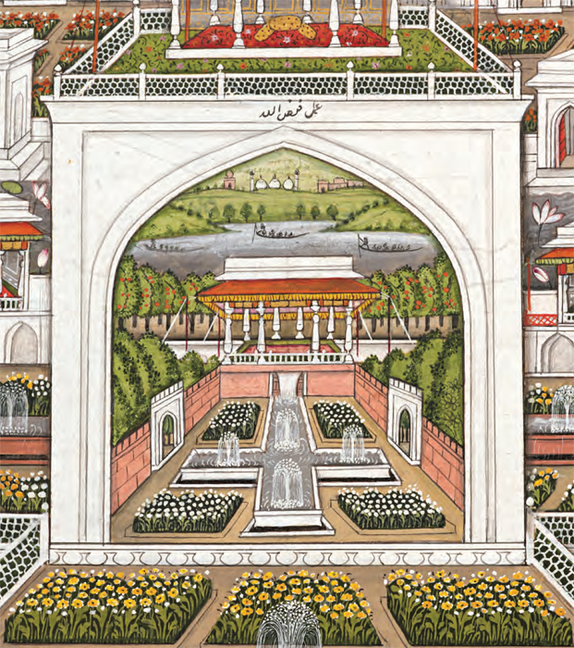
Close up of
Entertainment in a Palace
Signed by Faizabad Faizullah, India, ca. 1765–1770,
Opaque watercolour and gold on paper, 50.5 cm × 69.2 cm
© The Aga Khan Museum, AKM921

Slide 5
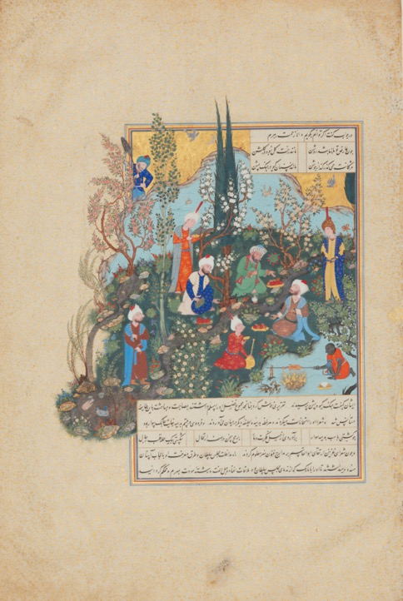
Firdausi and the Three Poets of Ghazna
Folio from the Shahnameh (Book of Kings)
of Shah Tahmasp
Attributed to Aqa Mirak, Iran, Tabriz, ca. 1532
Opaque watercolour, ink, and gold on paper
47 cm x 31.8 cm
© The Aga Khan Museum, AKM156

Slide 6
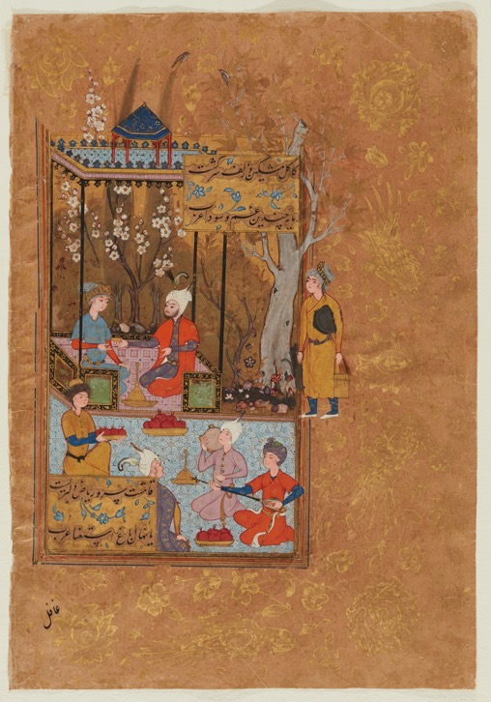
Princely Entertainment in a Garden
Folio from a manuscript of the collected works (Divan) of Sultan Ibrahim Mirza (Fol.19)
Creator: Artist (Calligrapher)
Abdullah al-Muzahhib 1582-83
Opaque watercolour, ink, gold and silver
on paper 23.9 cm x 16.8 cm
© The Aga Khan Museum, AKM282.19

Slide 7
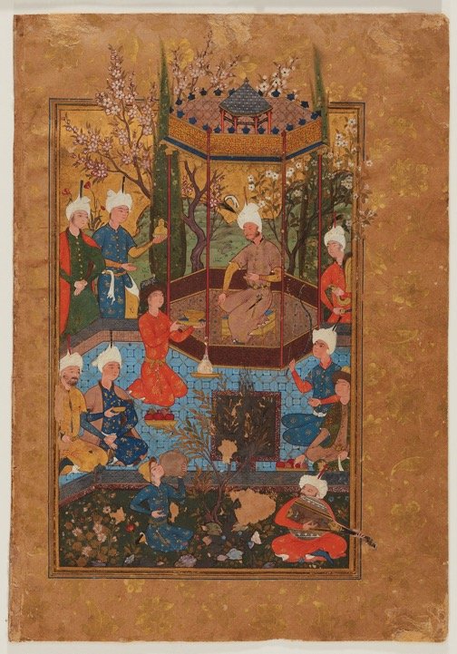
A Festive Garden Party
Folio from a manuscript of the collected works (Divan) of Sultan Ibrahim Mirza (Fol.86)
Creator: Artist (Calligrapher)
Abdullah al-Muzahhib 1582-83
Opaque watercolour, ink, gold and silver
on paper 23.9 cm x 16.8 cm
© The Aga Khan Museum, AKM282.86

Slide 8
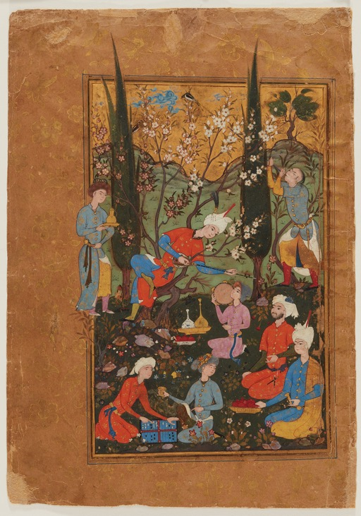
Royal and Courtly Figures Relaxing
at a Bazm
Folio from a manuscript of the collected works (Divan) of Sultan Ibrahim Mirza (Fol.87)
Creator: Artist (Calligrapher)
Abdullah al-Muzahhib 1582-83
Opaque watercolour, ink, gold and silver
on paper 23.9 cm x 16.8 cm
© The Aga Khan Museum, AKM282.87

Slide 9
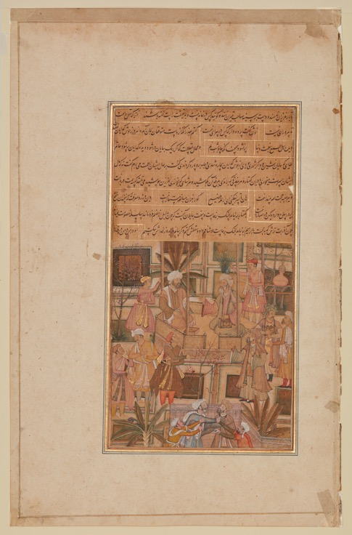
A Discussion in a Pavilion
Folio from the manuscript of Kulliyat (collected works) of S’di (d.1292)
Agra, India. ca. 1604
Opaque watercolour, ink and gold on paper
41.8 cm x 26.2 cm
© The Aga Khan Museum, AKM284.18

Slide 10
A Prince and his Beloved
Folio from the manuscript of Kulliyat
(collected works) of S’di (d.1292)
Agra, India. ca. 1604
Opaque watercolour, ink and gold on paper
41.8 cm x 26.2 cm
© The Aga Khan Museum, AKM284.21

Slide 11
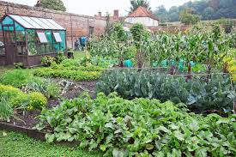
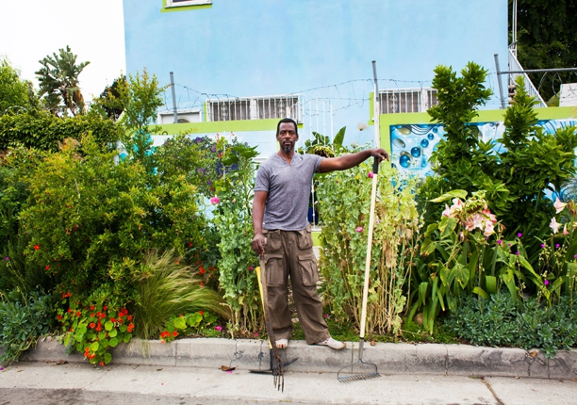
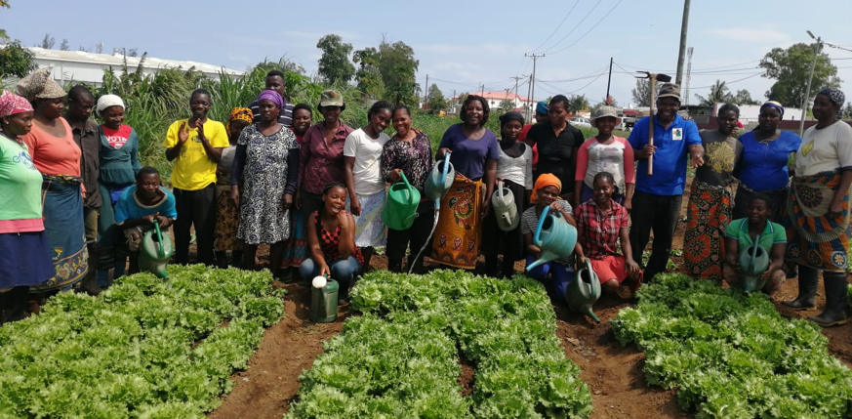
VEGETABLE PLOTS
Image 1: Gardeners World
Image 2: Avomacc
Image 3: Grist

Slide 12
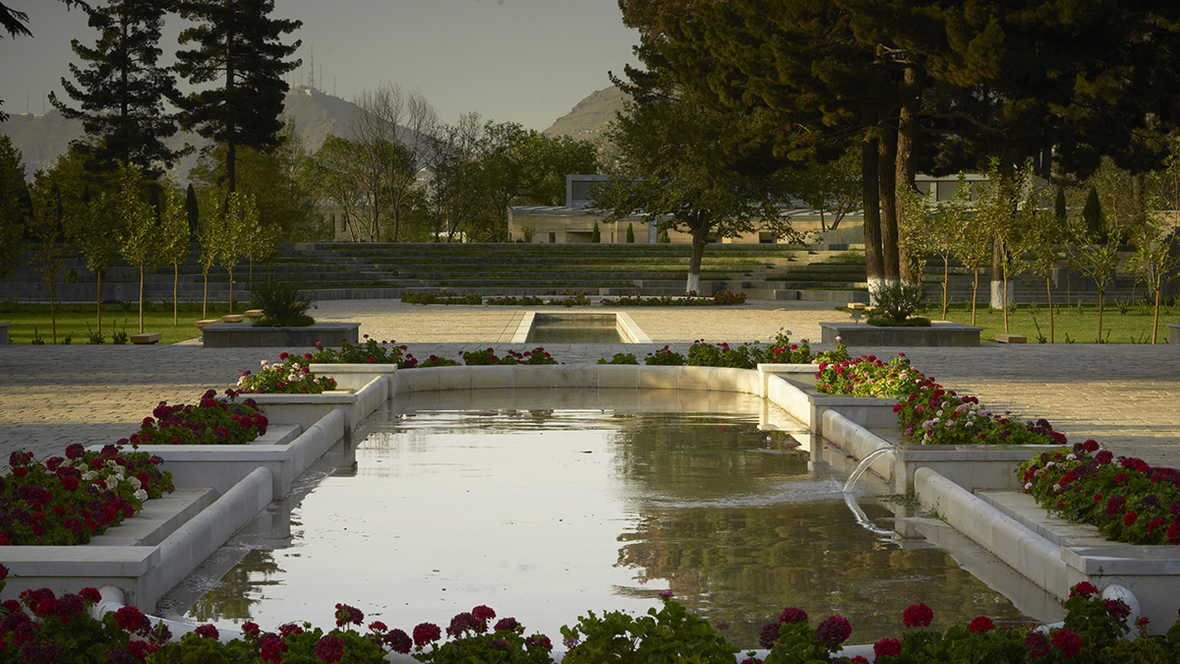
PALACE GARDENS
Image: Chihilsitoon Palace Gardens, Kabul
(Simon Norfolk, Archnet)

Slide 13
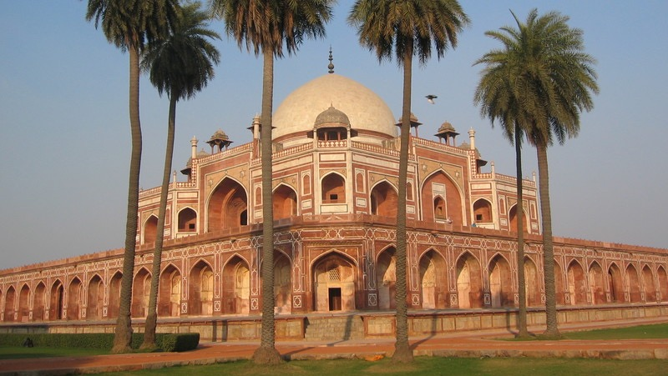
TOMB GARDENS
Image: Humayun’s Tomb, Delhi
(Ratish Nanda, Archnet)
Tomb: a monument to a dead person
or a where a dead person is laid to rest.

Slide 14
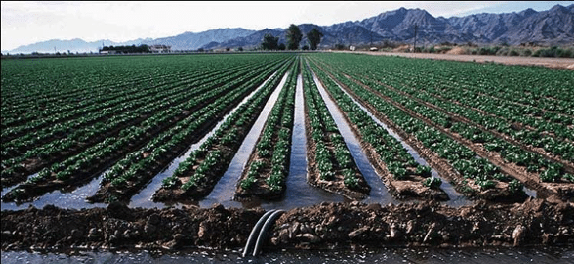
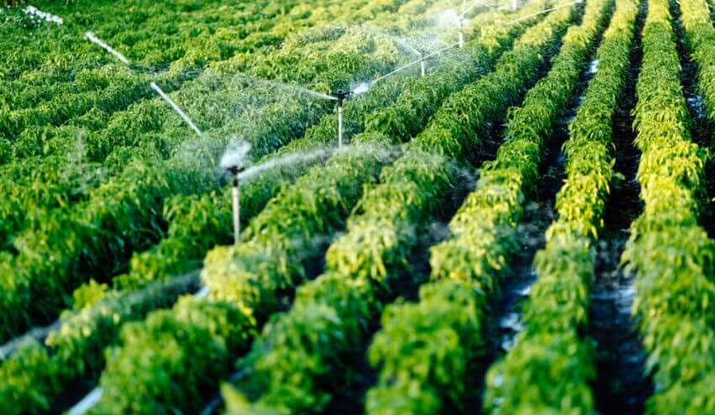
IRRIGATED FIELDS
Image 1: Irrigated field (Ugaoo)
Image 2: Furrow irrigation
(Research gate A.K. Mahbududhl Hye)

Slide 15
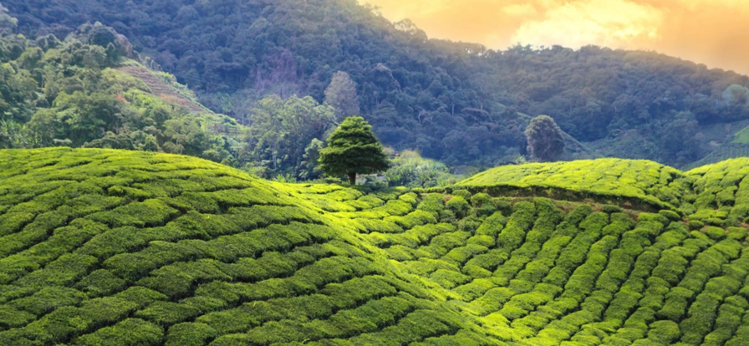
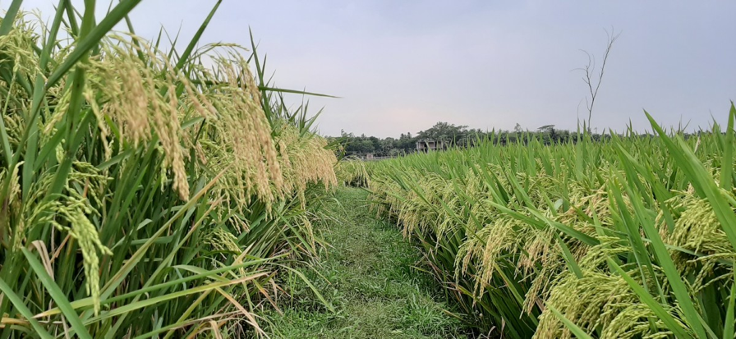
AGRICULTURAL
REGIONS
Image 1: Tea plantation, Kenya (TopicTea)
Image 2: Bangladesh paddy field (pxhere)

Slide 16
The chahar bagh
Gardens divided into four parts by
water channels or pathways
Close up of Entertainment in a Palace
Signed by Faizabad Faizullah, India, ca. 1765–1770,
Opaque watercolour and gold on paper,
50.5 cm × 69.2 cm
© The Aga Khan Museum, AKM921

Slide 17
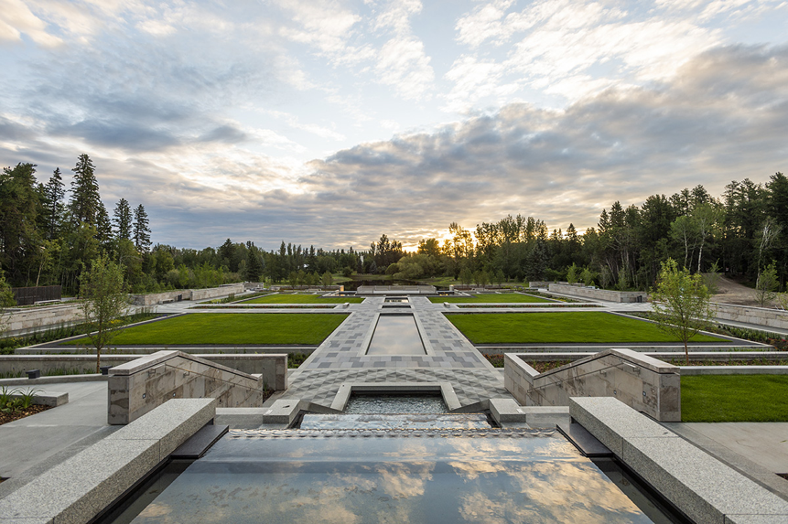
The Aga Khan Garden,
Edmonton – University of
Alberta Botanical Garden
View to the Chahar Bagh down the Nahr
Paul Swanson (Photographer)
Copyright: University of Alberta
Botanical Garden

Slide 18

LESSON 1.7:
RECREATING ENVIRONMENTS
(VISUAL ART)

Slide 19
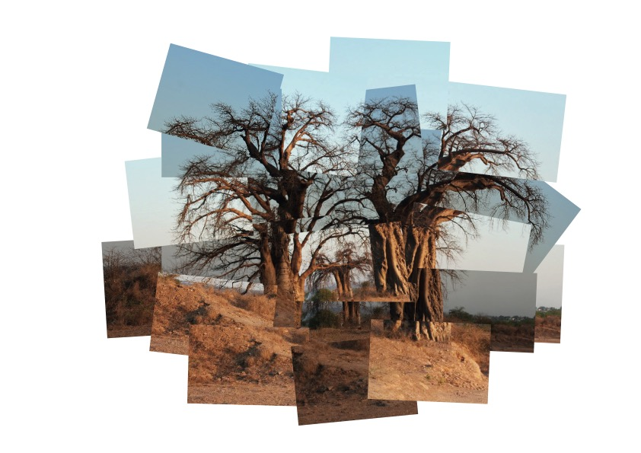
‘A photo doesn’t really have life in the way a drawing or painting does, ... as [the artist] puts hours and hours into creating it. A photograph is the other way round, it is a fraction of a second. As soon as you have looked at it for more than 4 seconds, you are looking at it far more than the camera did’.
David Hockney,
speaking on the South Bank Show in 1983
Imbondeiros Chatting
By Rebecca Nichols & Steph de Howes

Slide 20
LESSON 1.12:
A GREEN LUNG FOR CAIRO

Slide 21
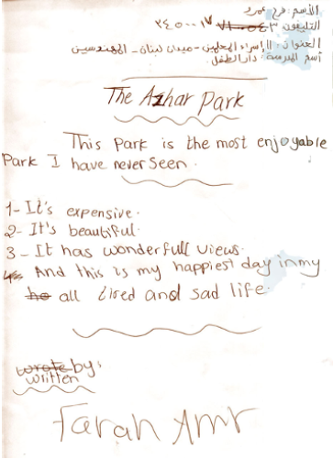

Slide 22
LESSON 1.14:
CREATING ART INSPIRED BY EXPERIENTIAL LEARNING

Slide 23
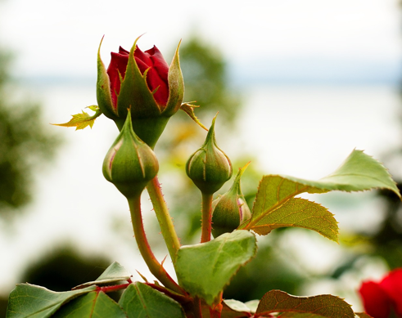
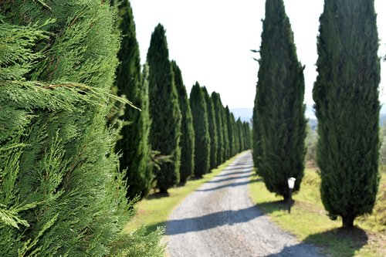
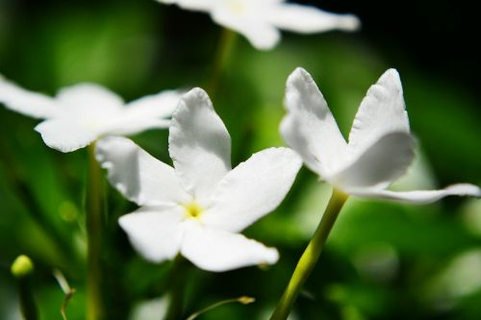
‘Behold the garden of the heart, green
and moist and fresh, full of rosebuds
and cypresses and jasmines.’ Rumi
Image sources: Needpix

Slide 24
LESSON 1.22:
CREATIVE COLLABORATIONS

Slide 25
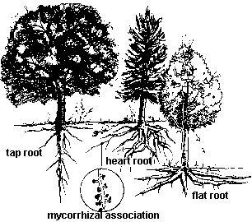
TREE ROOTS
Image source: https://www.webberlandscaping.com/trees-talk-to-each-other

Slide 26
LESSON 1.24:
TAKING INSPIRATION FROM NATURE

Slide 27
THINGS TO DO | THINGS TO AVOID
Commit and be open | Worrying about mistakes and being closed
Listen to other performers | Telling rather than showing
Support other performers | Shutting down other performers
Move the action forward | Forcing silliness

Slide 28
LESSON 1.25:
CREATING A GUIDE TO THE CAMPUS

Slide 29
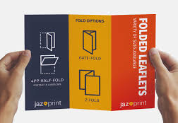
Fold out leaflet Image source: Jazprint https://www.jazprint.co.uk/product/folded-leaflets-flyers-gatefold-z-fold/

Slide 30
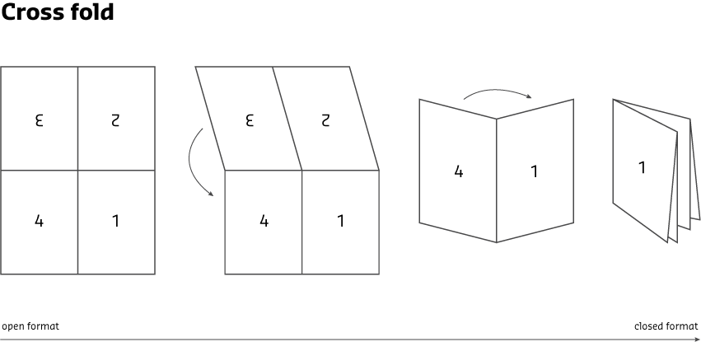
Cross fold leaflet Image source: https://www.saxoprint.co.uk/blog/cross-fold-leaflets

