Slide 1
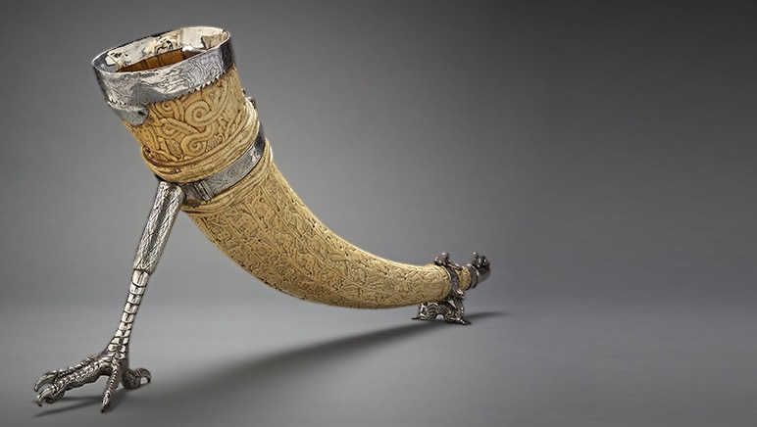

COMPANION SLIDES
MYP 2 WELL-BEING:
EVOLVING IDENTITIES
AND NAVIGATING
CULTURES
Notes:
These slides are for use with the Teacher Guide for the MYP2 Well-being unit: Evolving Identities and Navigating Cultures. Please read the Teacher Guide before using the slides.

Slide 2


LEARNING EXPERIENCE 2.2
UNIVERSAL CHARACTERISTICS

Slide 3
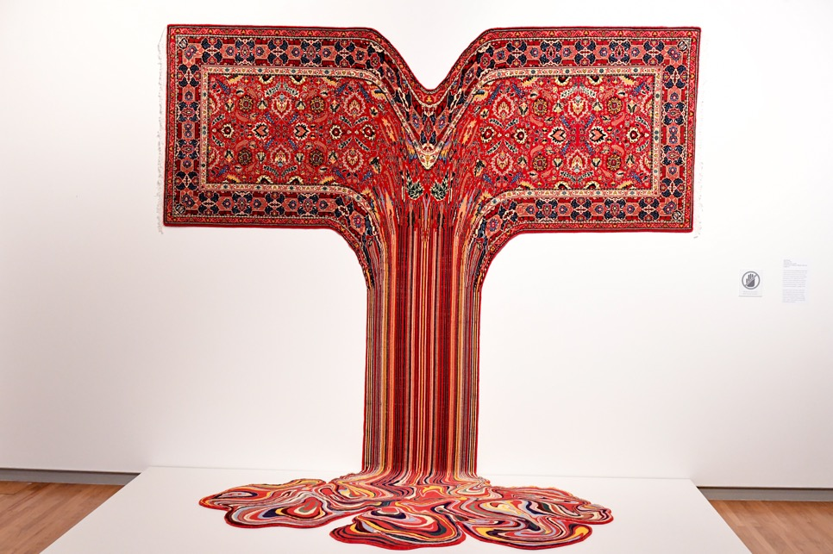
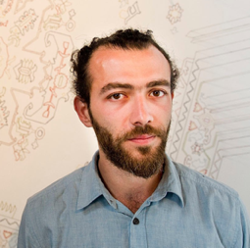
Gautama (2017)
Faig Ahmed
(Left) Gautama
© The Aga Khan Museum,
photo by Akber Dewji
Courtesy of Sapar Contemporary,
Faig Ahmed and Collection Majudia.
(Below) Faig Ahmed
Photographer Marco Secchi,
Getty Images

Slide 4
Debatable Question:
To what extent are we connected by universal characteristics?

Slide 5
LEARNING EXPERIENCE 2.3
TO WHAT EXTENT IS
IDENTITY FIXED?

Slide 6
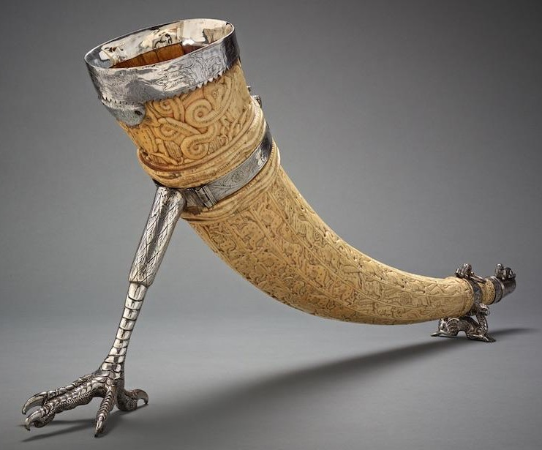

Slide 7
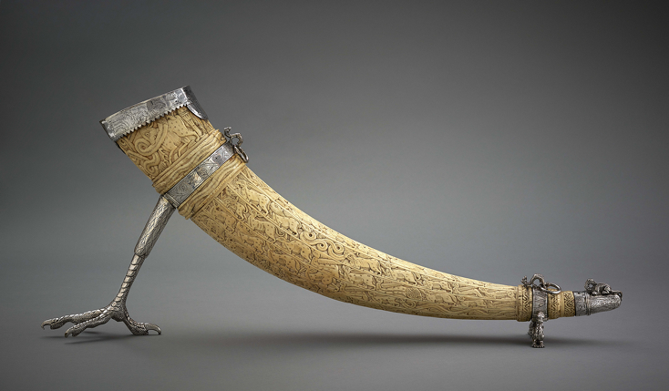
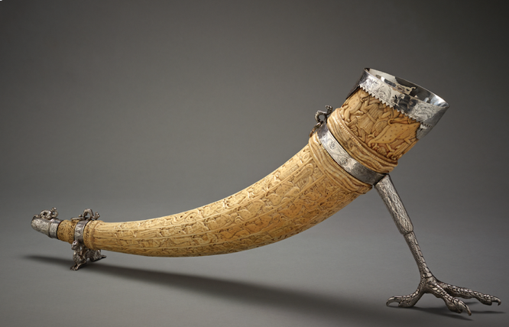

Slide 8
THE OLIPHANT’S JOURNEY

Slide 9
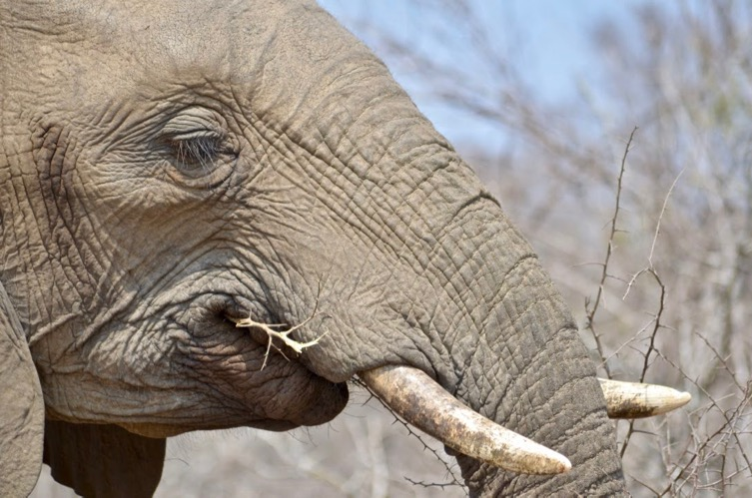
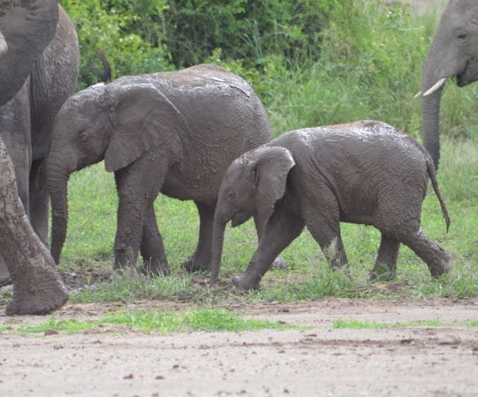
African Elephants
Photographer: Rebecca Nichols

Slide 10
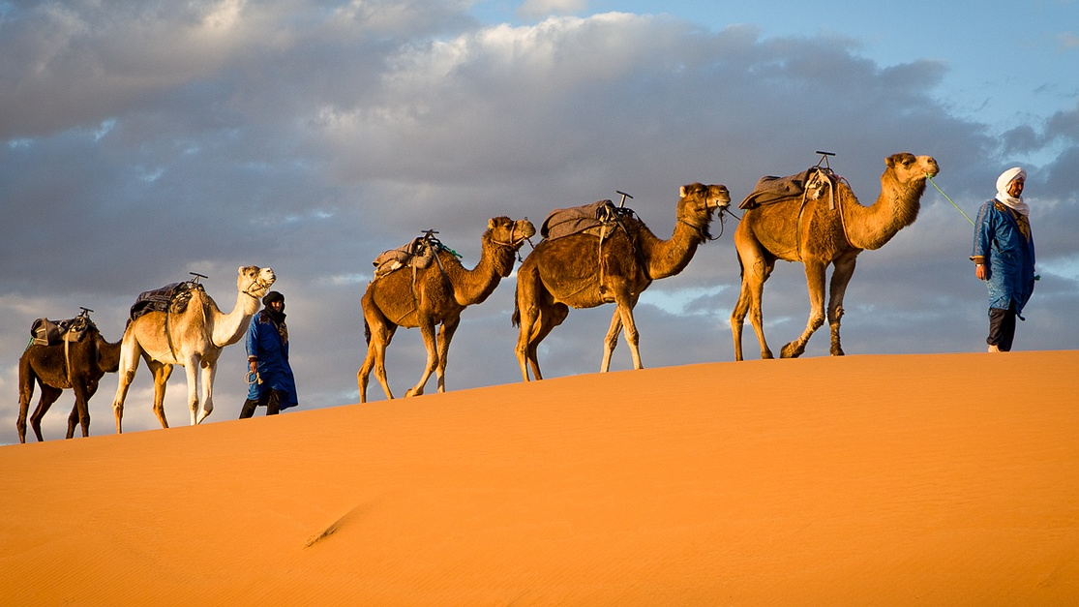
Camel train transporting goods across the Sahara
Image source: ancient.eu

Slide 11
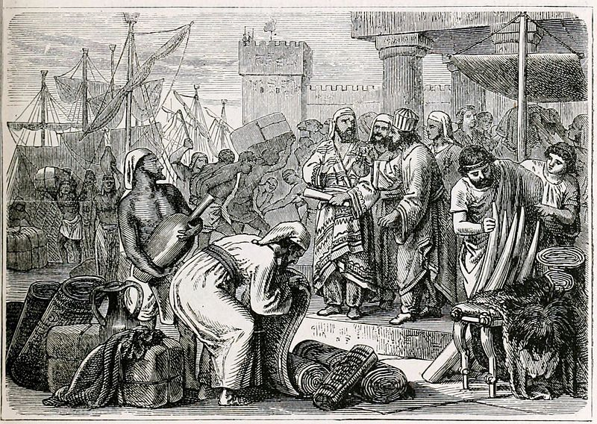
Image Source: History of the World,
Ward, Lock & Co, New York
Medieval merchants
trading

Slide 12
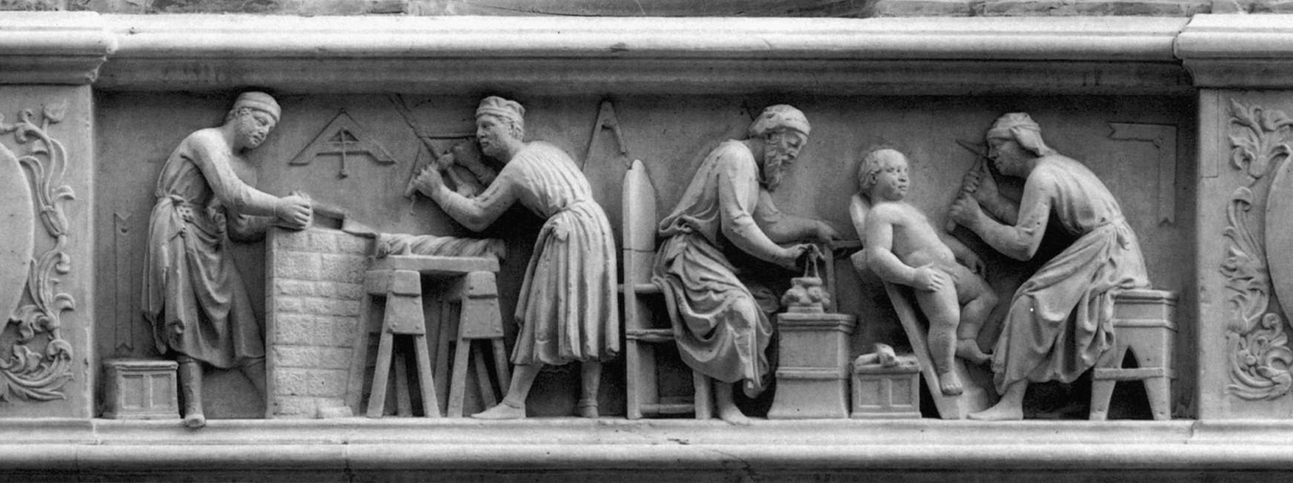
Sculptors at work, circa 1416,
Orsanmichele Church Florence
Image source: webgalleryofart

Slide 13
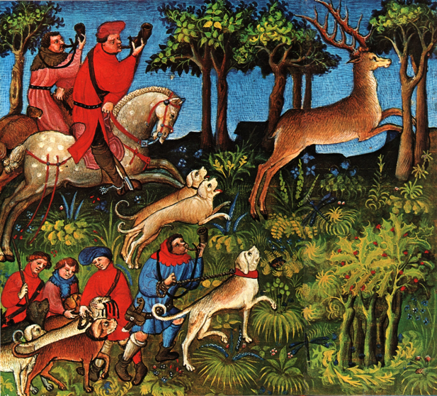
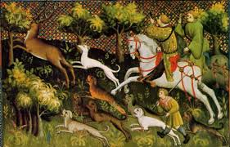
Norman nobleman hunting
(Left) Picture from Livre de La Chasse by Gaston Phoebus, a Medieval manuscript with illuminations.
(Right) Image source: gallery.nen.gov.uk
www.reimer-mann-verlag.de/tondokumente2/index_mann.php

Slide 14
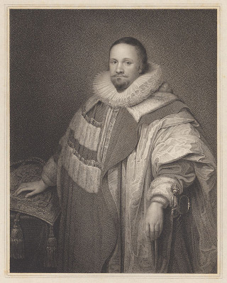
Thomas Coventry, Lord Keeper
of the Great Seal of England,
1st Baron of Allesborough
(1578-1640)
Image source: Worcestershire County Council

Slide 15
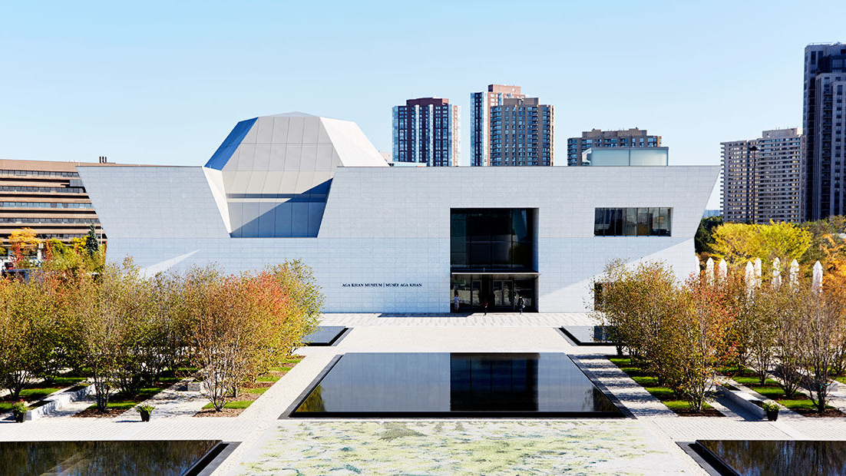
Aga Khan Museum, Toronto
Photographer: Janet Kimber

Slide 16
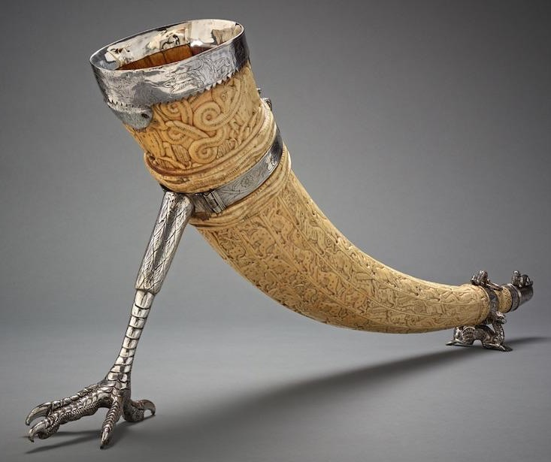
Oliphant (ivory horn), probably Southern Italy, late 11th to late 12th century, silver mounts made in England, c. 1620, carved ivory with silver mount © The Aga Khan Museum, AKM809

Slide 17
LEARNING EXPERIENCE 2.4
WHO AM I & WHO ARE WE?

Slide 18
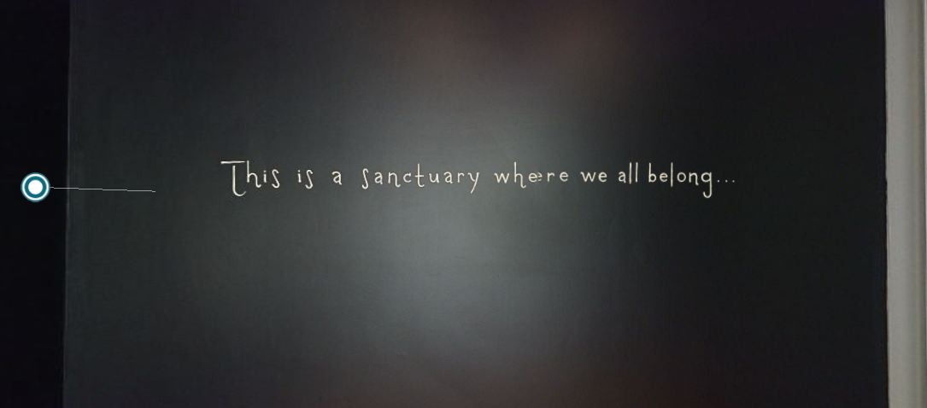
3D Virtual Tour of the Sanctuary Exhibition
Notes:
Contains hyperlink

Slide 19
LEARNING EXPERIENCE 2.6
ASK ME WHERE I’M FROM:
MEMORIES

Slide 20

Curator’s Tour:
Don’t Ask Me Where I’m From with Marianne Fenton
Notes:
Contains hyperlink

Slide 21
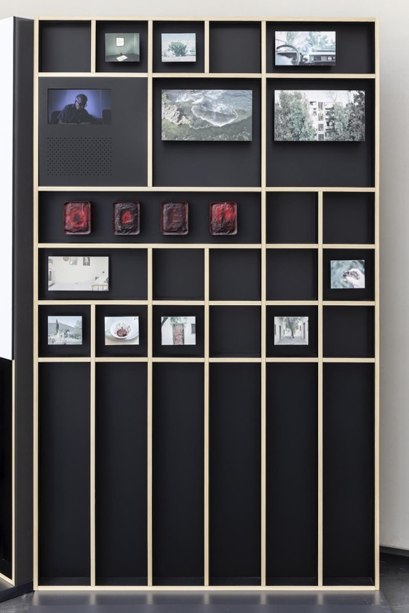
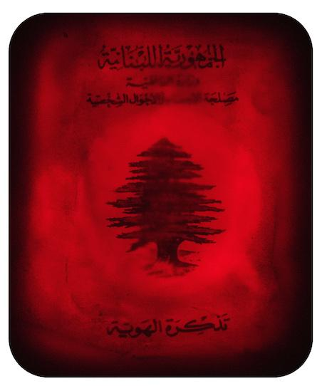

Tcharafna
(I am honoured
to meet you)
Gui Mohallem
(Left) Photographer: Marco Pavan
(Below) Photographer: Janaina Miranda

Slide 22
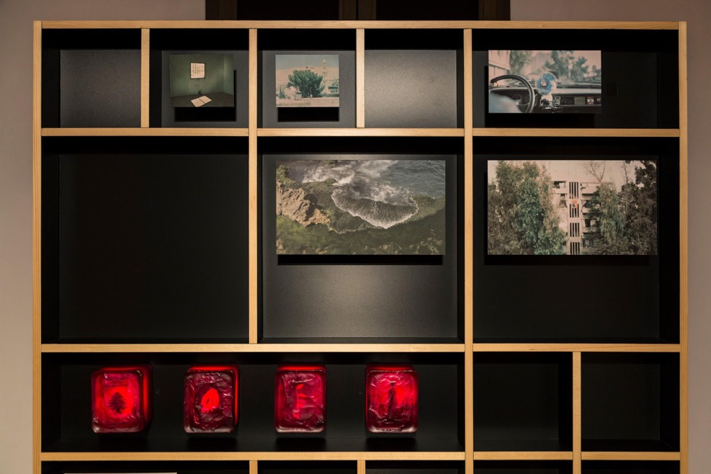
Photographer: Toni Hafkensheid

Slide 23
LEARNING EXPERIENCE 2.7
ASK ME WHERE I’M FROM:
LANGUAGE

Slide 24
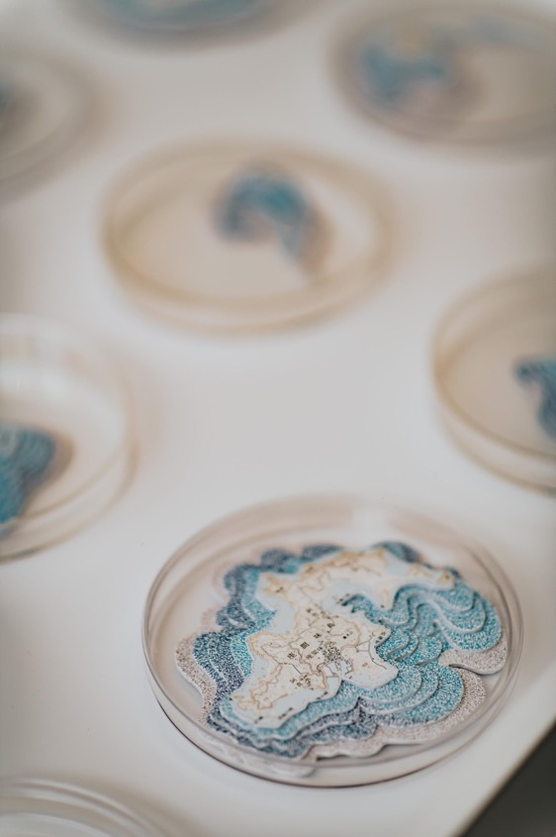
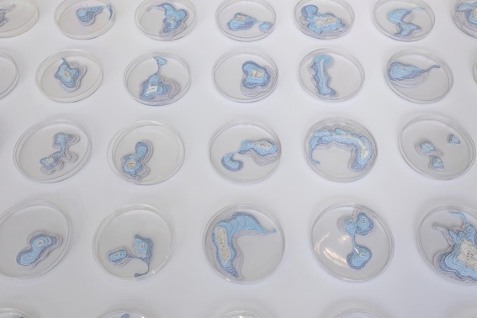
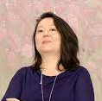
Islands (Ilhas)
Érica Kaminishi
(Left) Photographer: Alyssa Katherine Faoro,
(Middle) Photographer: Toni Hafkenscheid,
(Right) www.ericakaminishi.com

Slide 25
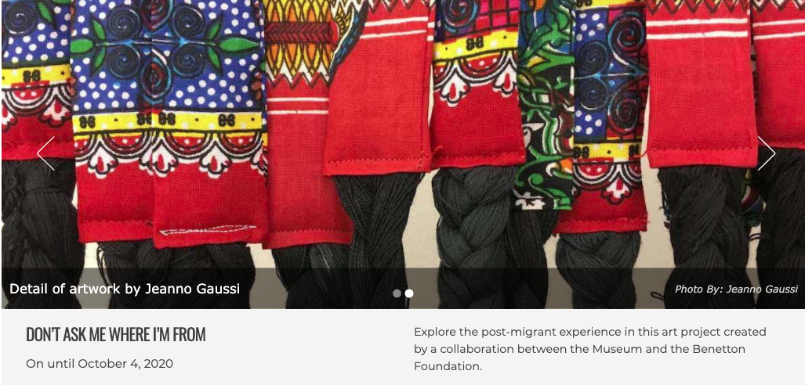
Don’t Ask Me Where I’m From Exhibition
Notes:
Contains hyperlink

Slide 26
LEARNING EXPERIENCE 2.8:
LAYERS OF IDENTITY – BENEATH
THE SURFACE OF ASTROLABE

Slide 27
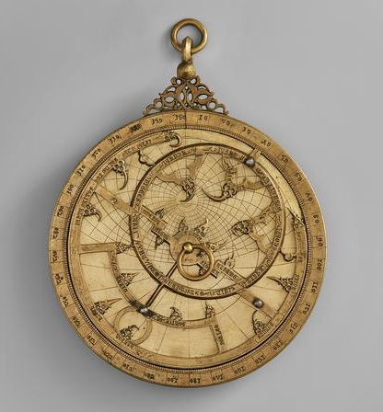
What do you notice when you look carefully?

Slide 28
What do you think
this might be, and why?

Slide 29
What may it be used for?

Slide 30
What may it be made from?

Slide 31
Who may have
used this?

Slide 32
What do you wonder about why it was created?

Slide 33
What do you wonder about how it may be used?

Slide 34
What do you think it is, if you are told that it is called a planispheric astrolabe?
Astrolabe, Spain, 14th century, bronze, engraved and inlaid with silver,
diameter: 13.5 cm
© The Aga Khan Museum, AKM611

Slide 35
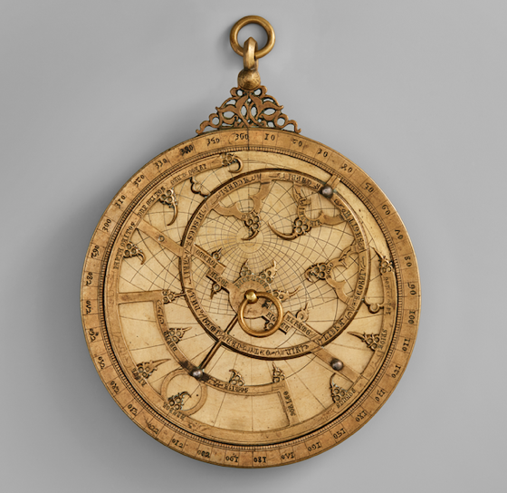
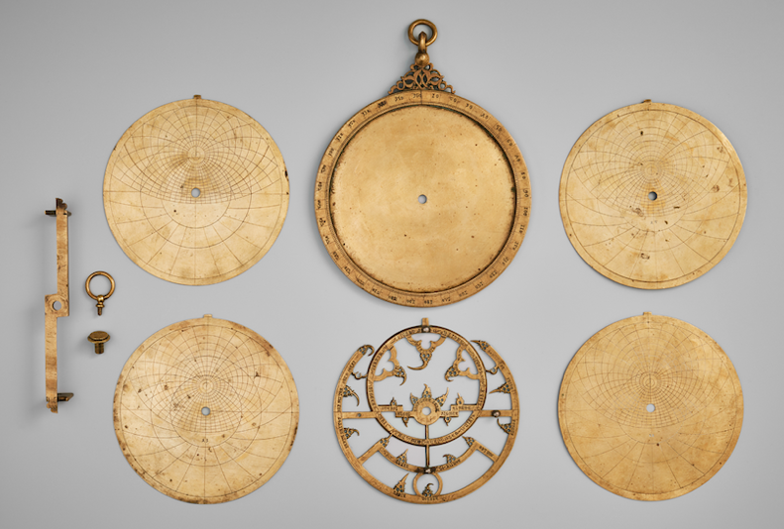
The Layers of the Astrolabe

Slide 36
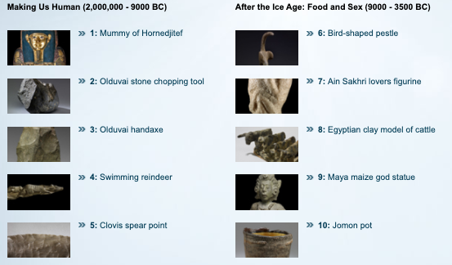
The British Museum and BBC A History of the World
Notes:
Contains hyperlink

Slide 37
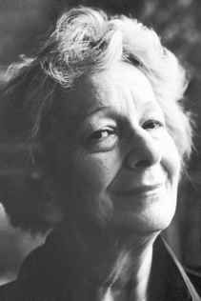
‘You can find the entire cosmos lurking in its least remarkable objects.’
Wislawa Szymborska
Photograph: from the Nobel Foundation archive

Slide 38
LEARNING EXPERIENCE 2.9
MY IDENTITY AND MY
SELF-ESTEEM

Slide 39
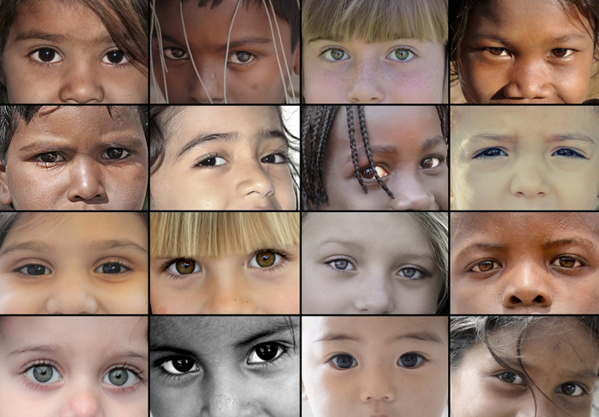
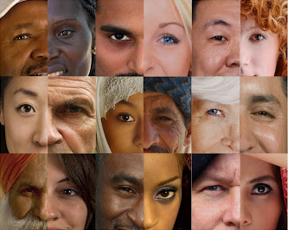

Slide 40
SOS MEDITERRANEE –
Eyes of Children around the World
1000 piece jigsaw puzzle
Image source: www.jigsawpuzzle.co.uk/grafika-sos-mediterranee-eyes-of-children-around-the-world-jigsaw-puzzle-1000-pieces.p55288.html
Multicultural Faces
Geoff Allen, 2009
www.geoff-allan.co.uk
Image source: http://geoffallan.blogspot.com/2009/04/

